Slide 1

Working with REST APIs in PowerShell
@JONATHANMEDD
@PSSouthampton

Slide 2
DEMO Heavy
All the examples are in my GitHub repo, so no need to try and copy them down
https://github.com/jonathanmedd/Presentations/tree/master/PowerShell/Working%20with%20REST%20APIs%20in%20PowerShell

Slide 3
REST– what is it?
Representational state transfer (REST) or RESTful web services are a way of providing interoperability between computer systems on the Internet.
REST-compliant Web services allow requesting systems to access and manipulate textual representations of Web resources using a uniform and predefined set of stateless operations. Other forms of Web services exist which expose their own arbitrary sets of operations such as WSDL and SOAP

Slide 4







Rest – examples of systems you might integrate with

Slide 5
Mandatory context slide
What is the point of this? Why might I need to know about it?
Maybe you need to:
Execute a one-off query to retrieve some information
Execute multiple requests to make a bunch of things happen in a system
Create an app or a toolkit which interacts with the system
e.g. a social media app
or a PowerShell toolkit for a system which doesn’t have one – like PowervRA

Slide 6
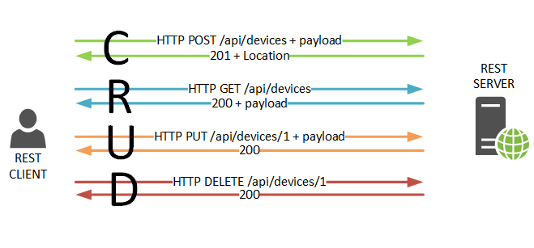
REST– what is it?

Slide 7
REST – Common verbs and comparison
REST | CRUD | PowerShell
POST | Create | New-*
GET | Read | Get-*
PUT | Update | Set-*
DELETE | Delete | Remove-*

Slide 8
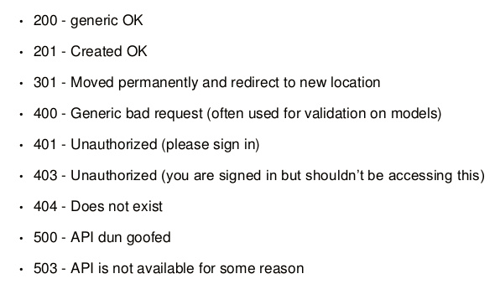
Rest – common response codes

Slide 9
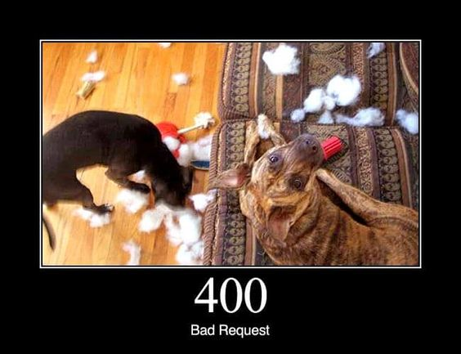
Rest – common response codes

Slide 10

Rest – common response codes

Slide 11

Rest – common response codes

Slide 12
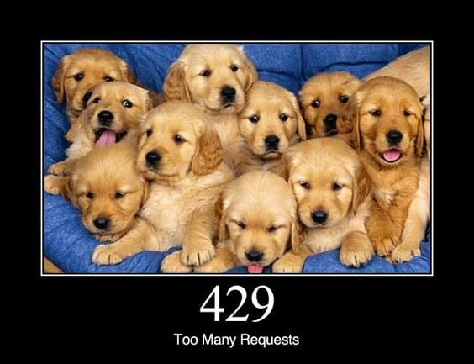
Rest – common response codes

Slide 13
PowerShell implementation
Invoke-RestMethod
Invoke-WebRequest
Introduced in PowerShell 3.0
Minor improvements up to 5.1
Significant changes in PowerShell Core (more on that later)

Slide 14
Invoke-RestMethod vs Invoke-webrequest (pre-PS Core!)
Both very similar, share the same core logic for submitting requests
Differ mostly when it comes to processing the results
Invoke-WebRequest
Uses IE COM API to parse results, unless –UseBasicParsing specified
Invoke-RestMethod
Attempts to parse results expecting JSON or XML
Does not support HTML
May not be possible to examine headers you need in the response

Slide 15
Invoke-RestMethod and Invoke-webrequest
Demo

Slide 16
REST Authentication (Pre PS Core)
Basic
Token
Demo using vRA and vRO

Slide 17

Changes, Improvements and what’s missing in PS Core
Follow Mark Kraus - https://twitter.com/markekraus
“If PowerShell is to survive as a modern scripting language, it needs immaculate support for web requests and it needs to be flexible enough to work with the various web API implementations”

Slide 18
Changes, Improvements and what’s missing in PS Core
Reminder:
Windows PowerShell 5.1 uses the full fat .NET Framework
PowerShell Core 6.0.0 uses .NET Core
.NET Core is a cross-platform open source subset of .NET Framework
Not everything you can do in .NET Framework is available in .NET Core
Not everything you can do in .NET Framework would make sense in a cross-platform world
E.g. trying to work with the Registry on a Linux machine
Video summary: https://channel9.msdn.com/Blogs/NET-Core/What-is-NET-Core

Slide 19
Changes, Improvements and what’s missing in PS Core
Switch from Webrequest to HttpClient – effectively the Web cmdlets have been rewritten
Win PS 5.1 uses System.Net.WebRequest
Older, with a wider range of support for protocols outside HTTP
PS Core 6.0.0 uses System.Net.Http.HttpClient
Newer, introduced in .NET 4.5, designed for use with modern REST APIs
There is a pretty good chance you will need to update 5.1 code using the web cmdlets for 6.0.0

Slide 20
Changes in PS Core
Demo

Slide 21
What’s missing / Removed/ Still Outstanding in PS Core
Demo

Slide 22
Improvements in PS Core
Demo

Slide 23
resources
Mark Kraus series on Web Cmdlets in PS Core
https://get-powershellblog.blogspot.co.uk/2017/11/powershell-core-web-cmdlets-in-depth.html
https://get-powershellblog.blogspot.co.uk/2017/12/powershell-core-web-cmdlets-in-depth.html
https://get-powershellblog.blogspot.co.uk/2017/12/powershell-core-web-cmdlets-in-depth_24.html
PS Core 6.1 Web Cmdlets Roadmap
https://get-powershellblog.blogspot.co.uk/2018/01/powershell-core-61-web-cmdlets-roadmap.html

Slide 24
SUMMARY
The changes in the web cmdlets in PS Core 6.0.0 are a great step forward to bring REST functionality up to scratch for the modern programming world
It doesn’t stop here, there are more improvements on the way
Consider switching your code to use them ASAP going forward

